Slide 1
Project 4
Predicting Stock Price
By Alex Lu
September 2019

Slide 2
Problem
Predicting today’s stock price based on past 7 days open, close, low, high and volume data.
As an example, we use apple stock in our modeling. We will predict apple stock’s closing price based on past 7 days’ open, close, low, high and volume data.

Slide 3
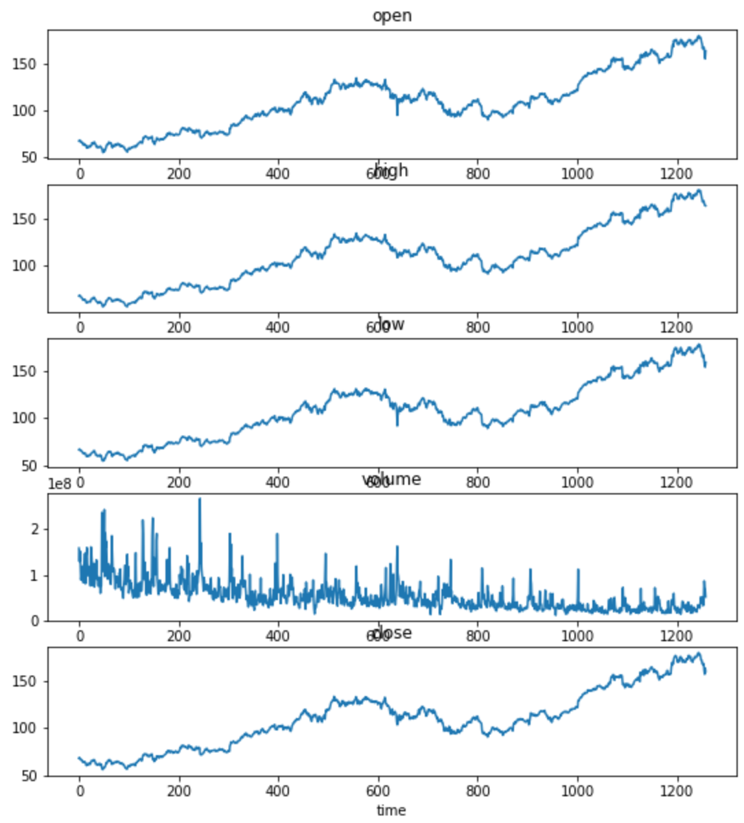
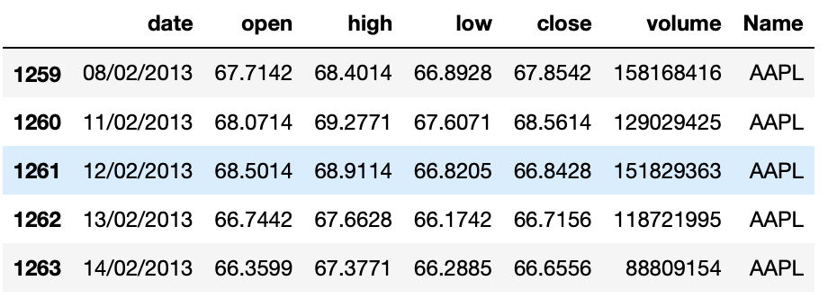
Data
Raw Data: source Kaggle. Very clean. First glance makes sense.

Slide 4
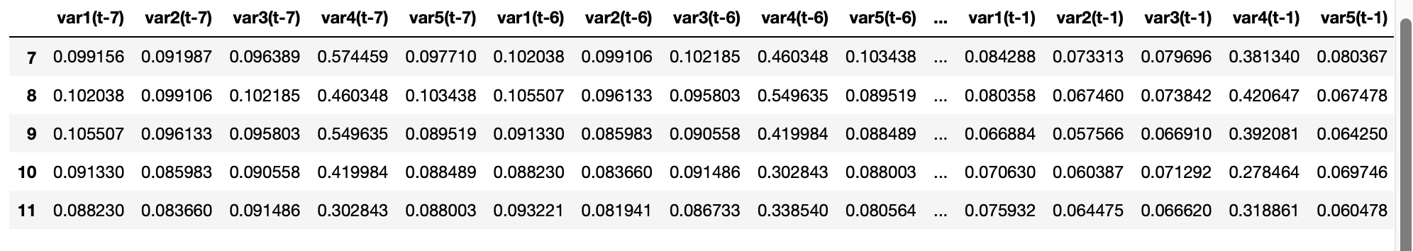
Solution
Intuition: a technical trader often takes consideration of previous days trading momentum when making a decision to buy or sell on any given day. These momentum are reflected in past historic price action: What were the volume in the stock? Was it making higher highs or lower lows? Was closed at bottom of the daily range or top? Hence, we use 5 data points per day (high, low, open, close, and volume.)
With 7 days lag (arbitrary decision for this model), and 5 data points per day, we have 35 input variables in the model.
Long Short Term Memory (LSTM) model: LSTM is type of RNN neutral network model that solves long time lag, and it is often used for time series problems like the one we are working on.

Slide 5
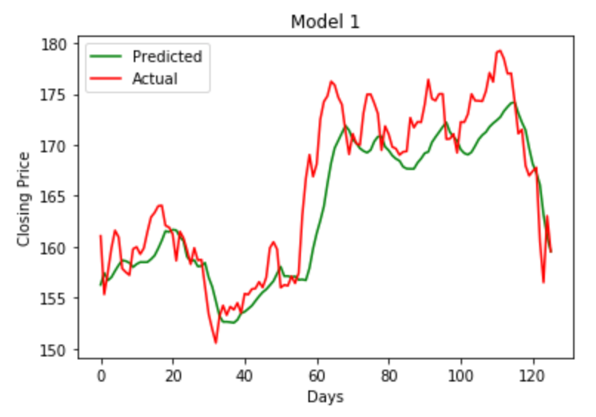
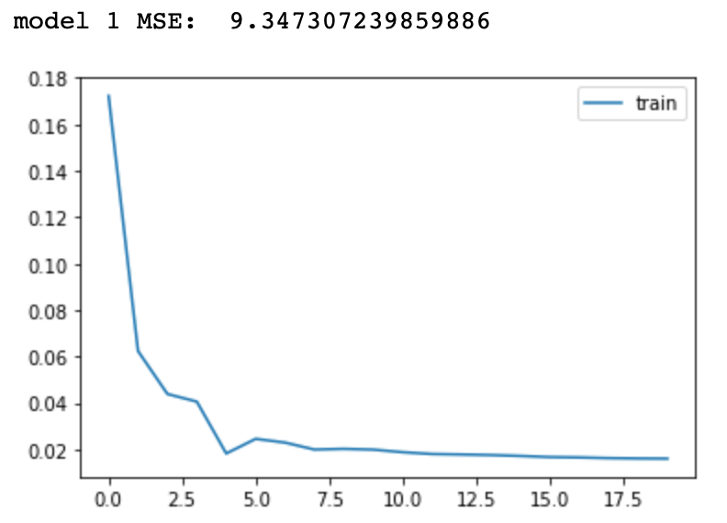
Results
Compare different models based on Mean Squared Error (MSE) measure, the simple model with one LSTM layer and one dense layer became the winner (with a MSE of 9.3). When comparing predicted closing price vs actual in the testing data, graphically, they tracks very well. However, there is a tendency of undervaluation in a bull market, and overvaluation in a sell off market.

Slide 6
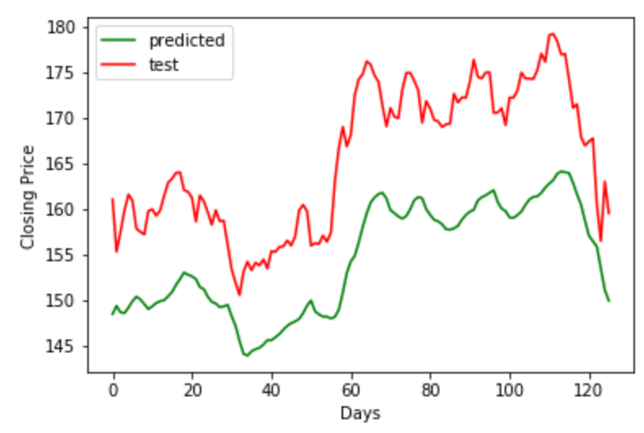
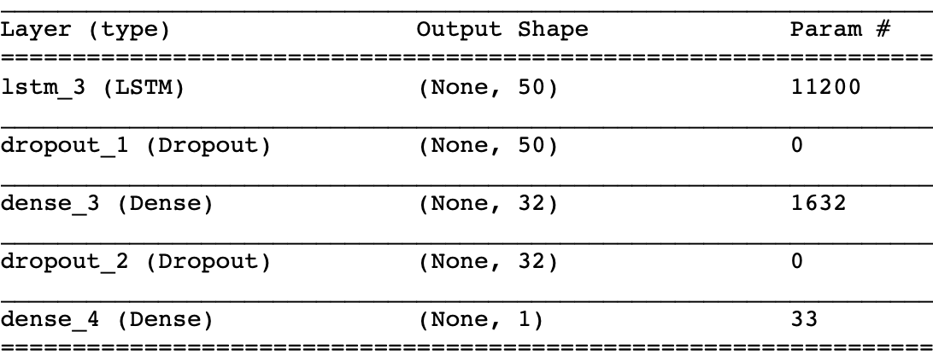
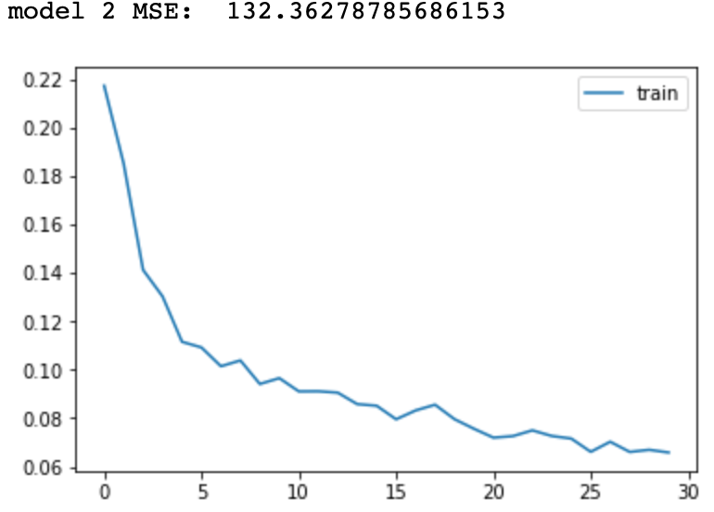
Results with other parameters
Model 2:
1x Lstm 50 nodes
1x Dense layer with relu activation
1x Dense layer with linear activation
Result: Terrible. The model seems to have a consistent downward bias.

Slide 7
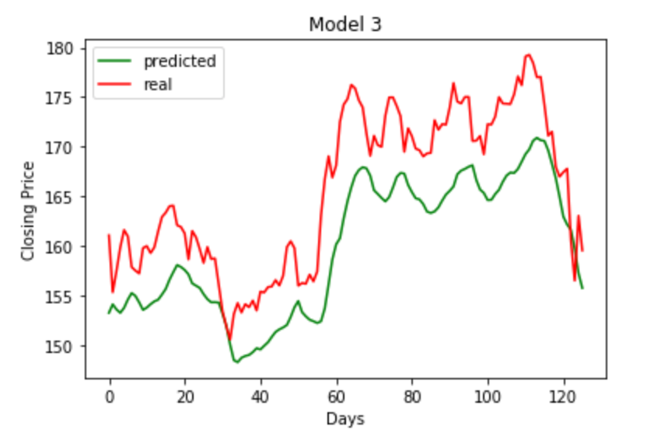
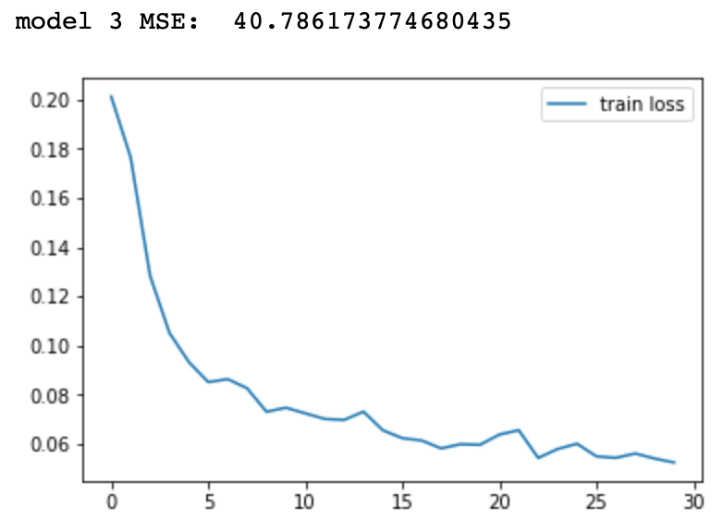
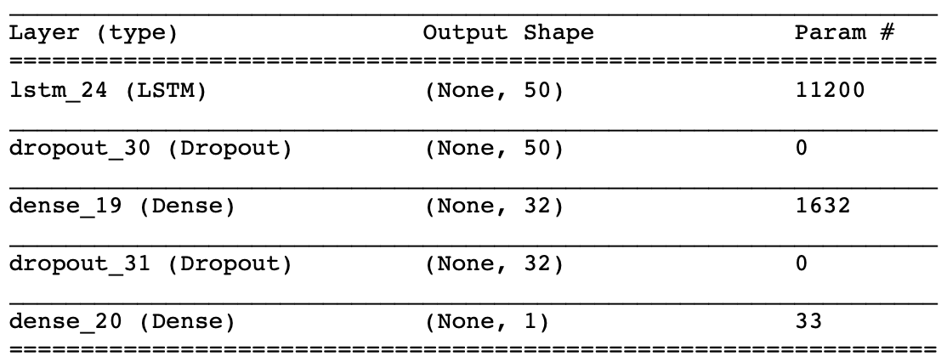
Results with other parameters
Model 3:
Same as Model 2 except activation linear
Result:
Better than model 2. Suggesting that linear activation in more appropriate than relu in this case.

Slide 8
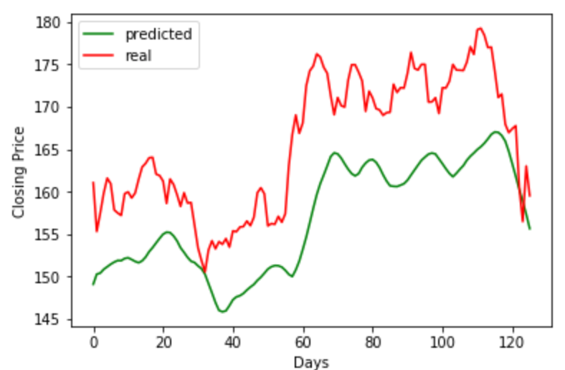
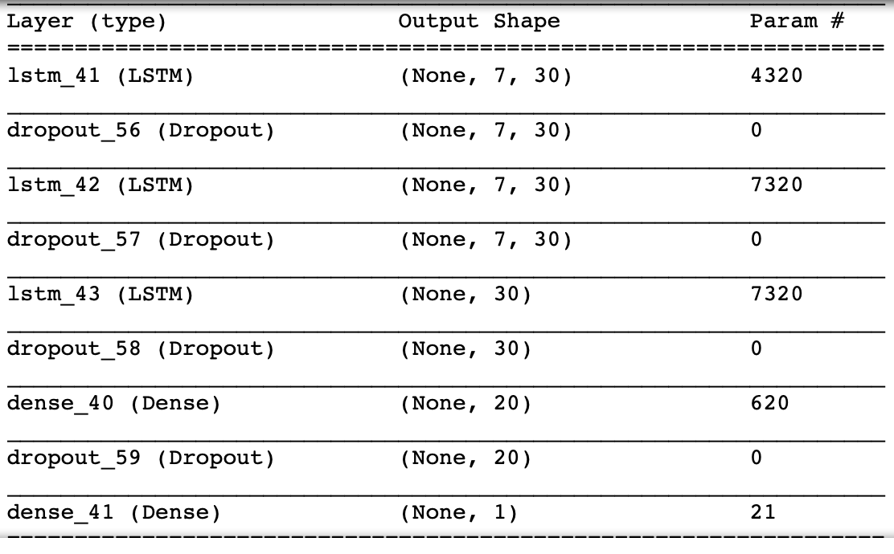
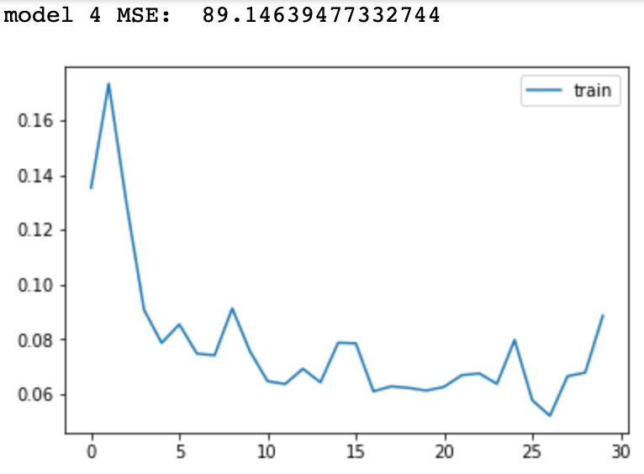
Results with other parameters
Model 4:
3x Lstm (loop through different node size 30, 40, 50)
2x Dense layer with linear activation
Result: the model with lower number of nodes seem to perform better on average with MSE ranging from 20 to 200. However, they are all worse than Model 1.

Slide 9
Conclusion
A simple LSTM model worked well in our case.
Model has a undervalue (predict < actual) tendency in the bull market, and overvalues vs actual when the market is selling off (bear market).
Complexity does not always improve modeling.
Business implication:
The model is a good guidance in a normal market trading environment.
However, the model is not suitable for prediction in unprecedented major event, such as 9/11 or financial crisis in 2007.
When trading with this model, stop loss trigger should be implemented rigorously, especially in the bear market.

Slide 10
THE END
THANK YOU FOR LISTENING!

